Slide 1
Sorting Visualizer
By
Shivam Korade - 50
Bhaven Rathod - 43
Shivaji Raut - 44
Manasi Godse - 22

Slide 2
Abstract
Although learning algorithms can be challenging, doing so is necessary for improving computational thinking and programming abilities. To solve this problem, we created the Algorithm Visualizer interactive online tool, which gives students a fun and interactive way to learn how different algorithms are implemented. With three various learning speeds” slow, average, and fast”
The application is made to support students in learning at their own pace. It also offers graphical representations of data and algorithms. The goal of the project is to make learning an amazing experience that inspires children to study more. This study examines the advantages of algorithm visualisation as a tool for better comprehending data structures and algorithms and introduces an interactive web-based tool.

Slide 3
Introduction
Sorting Visualizer is a tool that allows you to see how different sorting algorithms work visually. It helps to understand how each algorithm performs and which one is better for different scenarios.
Throughout this presentation, we will explore different types of sorting algorithms, from simple ones like bubble sort to more complex ones like merge sort or quick sort. We will see how each algorithm operates and understand their strengths and weaknesses

Slide 4
What is Sorting?
In the context of data structures and algorithms (DSA), sorting refers to the process of arranging a collection of elements or data in a particular order. The order could be ascending (from smallest to largest) or descending (from largest to smallest), depending on the desired outcome.
Sorting is an essential operation in computer science as it allows for efficient searching, data analysis, and organization of information. There are numerous sorting algorithms available, each with its own approach and characteristics. The choice of sorting algorithm depends on factors such as the size of the dataset, the specific requirements of the problem, and the desired efficiency.
The different types of sorting are:
Bubble Sort
Insertion Sort
Selection Sort
Quick Sort
Heap Sort

Slide 5
Bubble Sort
Bubble Sort is a simple sorting algorithm that repeatedly steps through the list, compares adjacent elements and swaps them if they are in the wrong order. Although it's easy to understand and implement, it's not efficient for large lists.
In first cycle,
Start by comparing 1st and 2nd element and swap if 1st element is greater.
After that do the same for 2nd and 3rd element.
At the end of cycle you will get max element at the end of list.
Now do the same in all subsequent cycles.
Perform this for (number of elements – 1) times.
You will get sorted list
A B A B
> <
20
10
10
20

Slide 6
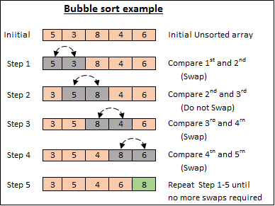

Slide 7
Insertion Sort
Insertion Sort is a sorting algorithm that builds the final sorted array one item at a time. It's efficient for small lists and is often used as part of more complex algorithms. It has a time complexity of O(n^2), but can be improved with some modifications.
Step 1 − If it is the first element, it is already sorted. return 1;
Step 2 − Pick next element
Step 3 − Compare with all elements in the sorted sub-list
Step 4 − Shift all the elements in the sorted sub-list that is greater than the
value to be sorted
Step 5 − Insert the value
Step 6 − Repeat until list is sorted

Slide 8
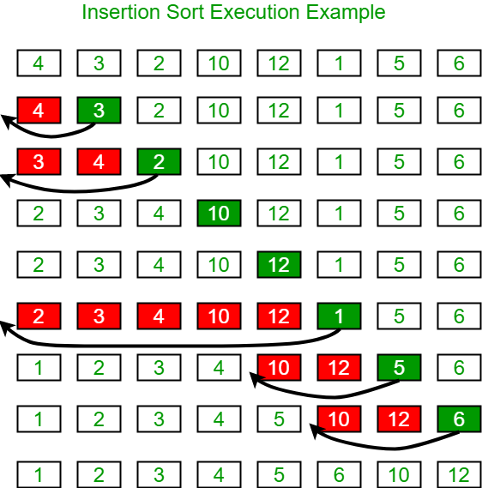

Slide 9
Selection Sort
Selection Sort is a simple sorting algorithm that repeatedly selects the smallest or largest element from the unsorted portion of an array and places it in its correct position within the sorted portion.
Find the minimum item in list and swap it with 1st element.
Now find the min. item in list excluding 1st item and swap it with 2nd element.
Likewise in each cycle exclude already swapped min. items and keep finding min. item in remaining list.
Perform such (number of elements – 2) cycles.
When remaining list size is 1 you get sorted list.

Slide 10
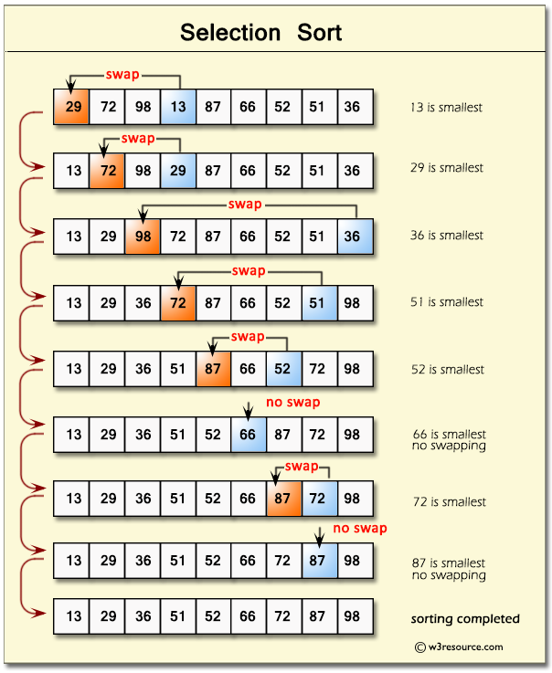

Slide 11
Quick Sort
Quick Sort is a widely used sorting algorithm based on the divide-and-conquer technique. It works by partitioning an array into two subarrays, according to a selected pivot element, and then recursively sorting the subarrays.
Select a pivot element from the array. The pivot can be chosen in various ways, such as the first, last, or middle element.
Partition the array by rearranging its elements such that all elements smaller than the pivot are placed before it, and all elements larger than the pivot are placed after it. After the partitioning, the pivot is in its final sorted position, and elements to its left are smaller, while elements to its right are larger.
Recursively apply the Quick Sort algorithm to the subarray before the pivot (elements smaller than the pivot) and the subarray after the pivot (elements larger than the pivot).
The recursion continues until the subarrays contain only one element or are empty. In this case, the subarrays are already sorted.
Combine the sorted subarrays to obtain the final sorted array.

Slide 12
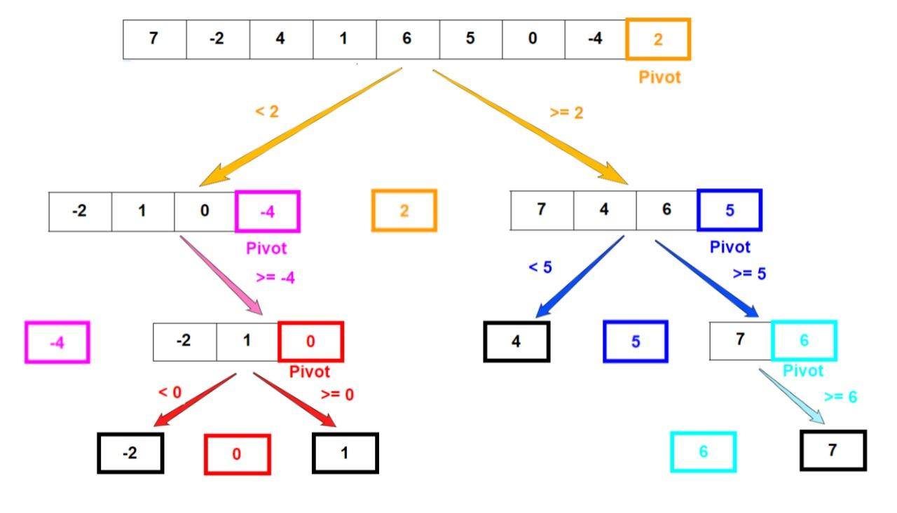
QUICK SORT

Slide 13
WEB TECHNOLOGY USED
The code includes various external JavaScript and CSS files to import necessary libraries and stylesheets.
The HTML structure consists of a navigation bar, a container for the sorting visualizer, and several buttons for user interaction.
The page allows users to adjust the size and speed of the sorting visualization using range input sliders.
The "New Array" button generates a new random array for sorting, and the "Stop Sorting" button is initially disabled.
The sorting algorithms available are Bubble Sort, Merge Sort, Selection Sort, Quick Sort, Insertion Sort, and Heap Sort. Each algorithm has a corresponding button that triggers the sorting process when clicked.
The JavaScript files for each sorting algorithm contain the actual implementation of the algorithm and are loaded asynchronously and deferred to ensure they don't block the rendering of the page.

Slide 14
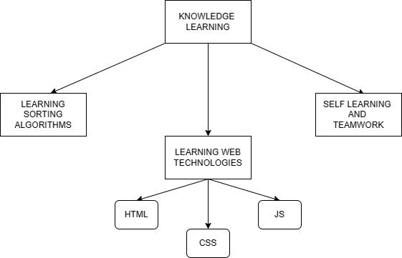
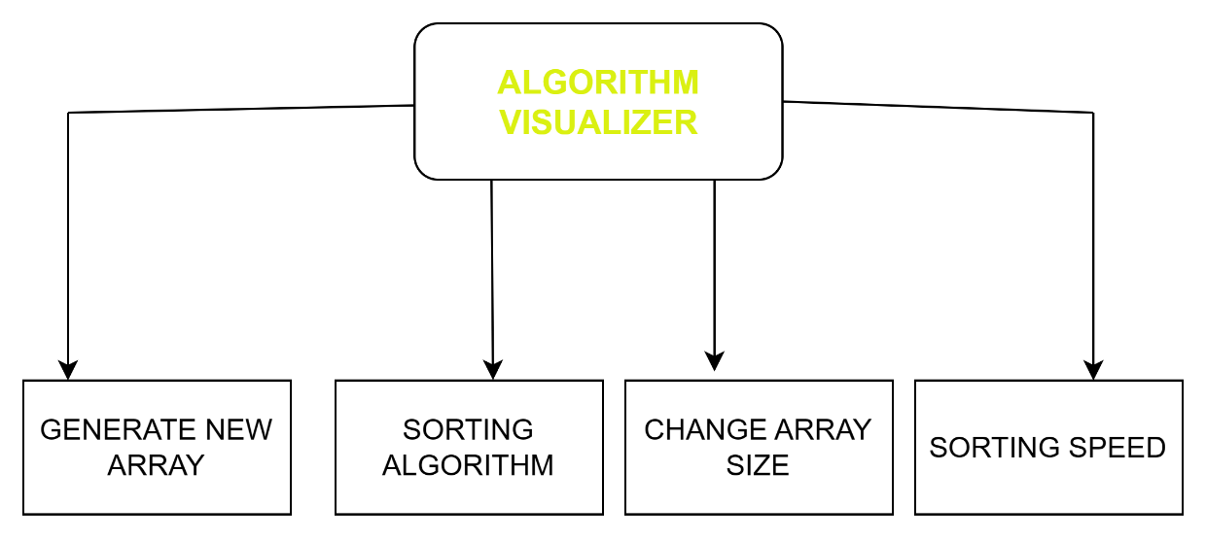
SYSTEM ARCHITECTURE

Slide 15
Applications
Education: Sorting algorithms are a vital concept in computer science, and the sorting visualizer can be an effective tool for educating students about them. By displaying a visual representation of how different algorithms work, students can gain a deeper understanding of the concepts and apply them to other areas of computer science. The sorting visualizer is particularly beneficial for students who are just starting to learn about sorting algorithms and may have difficulty comprehending abstract concepts.
Development: Developers frequently encounter situations where they need to sort data rapidly and efficiently. By using the sorting visualizer, developers can determine which algorithm would be best for their specific use case and optimize their code accordingly. The sorting visualizer can also assist in understanding the performance characteristics of different algorithms, such as their time and space complexity, and make informed decisions about which one to use.
Research: Computer science researchers can use the sorting visualizer to investigate the performance and behavior of different sorting algorithms. This can assist them in creating new algorithms or enhancing existing ones. By visualizing the sorting process, researchers can gain insights into how algorithms behave under different circumstances and identify areas for further research.

Slide 16
Gamification: Sorting algorithms may be tedious and uninteresting to learn about, but the sorting visualizer can make them enjoyable and engaging. By transforming the sorting process into a game, users can develop an interest in the subject and learn in a more enjoyable manner. This can be particularly helpful for younger students who may struggle to stay engaged with conventional teaching methods
Data Analysis: Data analysts and scientists often deal with large data sets that require rapid sorting. The sorting visualizer can assist them in determining which algorithm is best suited for their data and presenting the results in a meaningful manner. By providing a visual representation of the sorting process, data analysts can better understand how the algorithm works and make informed decisions about how to process and analyze their data.
In summary, the sorting visualizer project has many potential applications and can be beneficial to a wide range of users, from students to professionals. By providing a visual representation of sorting algorithms, users can gain a better understanding of the concepts and make informed decisions about how to apply them in their work.

Slide 17
Future Prospects
Expansion of Features: Your Sorting Visualizer project is already an excellent tool for visualizing the sorting process, but there are several potential features that could enhance the user experience. For instance, adding the ability to sort various data structures and allowing users to customize the visualization could make your project more useful and engaging to a broader audience.Integration with
Other Tools: Integrating your Sorting Visualizer with other tools or platforms could make it more valuable for users. For example, you could integrate it with popular development environments or online coding platforms, allowing developers to test and optimize their code efficiently. You could also integrate it with education platforms to make it easier for teachers to include your project in their lessons.
Community Building: Building a community around your Sorting Visualizer project could generate interest and engagement from users. You could create a forum or chatroom where users can share ideas and ask questions or organize coding challenges or competitions using your Sorting Visualizer. Building a community around your project can ensure its longevity and continued relevance in the future.
Overall, the future prospects for your Sorting Visualizer project are bright. By improving and expanding your project, you can make it a valuable tool for students, developers, researchers, and anyone interested in computer science and data analysis.

Slide 18
Conclusion
The sorting visualizer project is an indispensable tool for comprehending and visualizing sorting algorithms. By presenting a visual representation of how different algorithms work, users can gain a better understanding of the concepts and apply them to other areas of computer science.
This project has wide-ranging potential applications, from education to development, research, and more. As the project progresses and expands, there are many potential future prospects, such as incorporating new features, integrating with other tools, building a community, and extending into other areas of computer science. By continuously improving and expanding this project, it can become a valuable resource for anyone interested in computer science and data analysis.
In conclusion, the sorting visualizer project is a significant contribution to the field of computer science, and its potential applications and future prospects are exciting. By consistently improving and expanding the project, more users can gain a better understanding of sorting algorithms and other essential computer science concepts.

Slide 19
References
[1] “E-learning Tool for Visualization of Shortest Paths Algorithms” by Daniela Borissova and Ivan
Mustakerov, ResearchGate, July 2015.
[2] “Algorithm Visualization: The State” of the Field by Clifford A. Shaffer, Matthew L. Cooper, Alexander
Joel D. Alon, Monika Akbar, Michael Stewart, Sean Ponce and Stephen H. Edwardsacm Transactions on
Computing Education, Vol. 10, No. 3, Article 9, Pub. date: August 2010.
[3] “Visualizing sorting algorithms” by Brian Faria, Rhode Island College, 2017.
[4] P. Agrawal, H. Kaur, G. Singh, Indexed Tree Sort: An Approach to Sort Huge Data with
Improved Time Complexity, International Journal of Computer Applications 57(18)
(2012).
[5] A. D. Mishra and D. Garg, Selection of best sorting algorithm, International Journal of
Intelligent Information Processing 2(2) (2008), 363-368.
[6] R. Rahim, S. Nurarif, M. Ramadhan, S. Aisyah and W. Purba, December, Comparison
searching process of linear, binary and interpolation algorithm, Journal of Physics:
Conference Series, IOP Publishing (930)(1) (2017), 012007.

Slide 20
THANK YOU!

